Slide 1
Introduction to Computer Science
CSC115

Slide 2
Built-in/Helper Functions

Slide 3
Helper Functions
len() – this function is used to provide the length of strings, and many other data structures that we will use later. For now, lets see how many characters the string “Hello CSC115” contains:

Slide 4
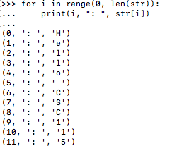
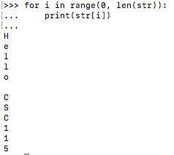
Helper Functions
Looping through a string
Traditional Loop Pythonic Loop

Slide 5
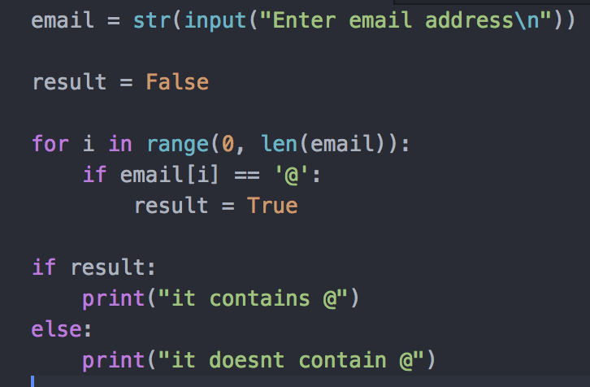
Helper Functions
Check whether a string contains ’@’ – Traditional

Slide 6
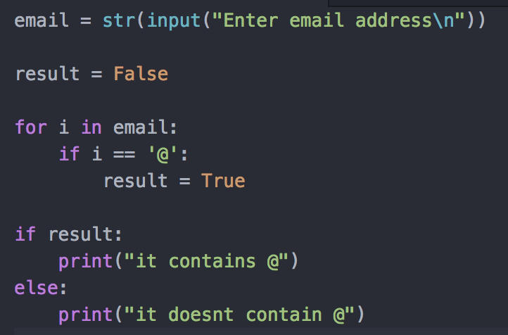
Helper Functions
Check whether a string contains ‘@’ – Pythonic

Slide 7
Slicing Strings
>>> x = "Hello World!"
>>> print(str[::]) ‘Hello World’
>>> print(str[0:3]) ‘Hel’
>>> print(str[3:5]) ‘lo’
>>> x[2:] 'llo World!’
>>> x[:2] 'He’
>>> x[:-2] 'Hello Worl’
>>> x[-2:] 'd!’
>>> x[2:-2] 'llo Worl’
>>> print(str[-1]) ‘d’
print(str[1:]) ‘ello world’

Slide 8
Helper Functions
upper() is a built-in function that will return a given string in capital case
Lower() is a built-in function that will return a given string in lower case

Slide 9
Helper Functions
random() is a built-in function that generates random values that can be floats or integers
We can specify the range of values to return
In order to use this library, we need to import random – which is a built in library in Python

Slide 10
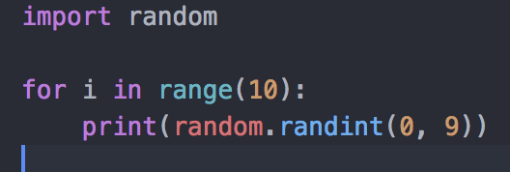
Random
The following code will generate 10 random integer values between 0 and 9 (range)

Slide 11
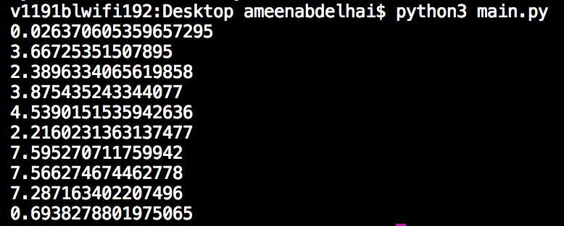
Random
The following code will generate 10 random floating-point values between 0 and 9 (range)

Slide 12
Random
The following code will generate 10 random floating-point values between 0 and 9 (range) – with formatted decimals

Slide 13
Decimal Format
{0} tells format to print the first argument
Everything after the colon ( : ) specifies the format_spec
.3 sets the precision to 3
g removes insignificant zeros
For g and G types, trailing zeros are not removed
For f, F, e, E, g, G types, the output always contains a decimal point
For o, x, X types, the text 0, 0x, 0X, respectively, is prepended to non-zero numbers.

