Slide 1
Introduction to Computer Science
Programming with Python

Slide 2
Variables & Expressions
Chapter 2

Slide 3
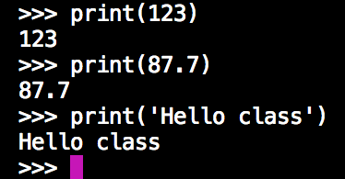
Constants
Fixed values such as numbers, letters, and string, are called “constants” because their value does not change
A constant is when, for instance, you say stack = 2 but then you cannot ever change what stack is pointing to or an error occurs.
Numeric constants are as you expect. E.g., x = 2
String constants use single (‘) or double (”) quotes. E.g., x = “Hello”

Slide 4
Recap - Reserved Words - Vocabulary
You cannot use reserved words as variable names / identifiers
False | class | return | is | finally
None | if | for | lambda | continue
True | def | from | while | nonlocal
and | del | global | not | with
as | elif | try | or | yield
assert | else | import | pass | break
except | in | raise

Slide 5
Other Programming Languages
Most programming languages such as Java, C++, C#, etc, provide programmers with the opportunity for final or constant variables. For example:
What is the equivalent of // (the first screenshot on the left) in Python?
In Python, this option (constant) is not available, but, with some tweaks using objects, it can be. We will cover that in the coming lectures.

Slide 6
Variables
A variable is a named (given) place in the memory where a programmer can store data and later retrieve the data using the variable “name”
Programmers get to choose the names of the variables
You can change the contents of a variable in a later statement
>>> x = 12.2 x 12.2
>>> y = 14 y 14

Slide 7
Variables
A variable is a named (given) place in the memory where a programmer can store data and later retrieve the data using the variable “name”
Programmers get to choose the names of the variables
You can change the contents of a variable in a later statement
>>> x = 12.2 x 12.2 ?
>>> y = 14 y 14
>>> x = 100

Slide 8
Variables
A variable is a named (given) place in the memory where a programmer can store data and later retrieve the data using the variable “name”
Programmers get to choose the names of the variables
You can change the contents of a variable in a later statement
>>> x = 12.2 x 12.2 100
>>> y = 14 y 14
>>> x = 100

Slide 9
Python Variable Name Rules
Must start with a letter or underscore (_)
Must consist of letters, numbers, and underscores and NO spaces
Case sensitive
Good | spam total spam23 _speed
Bad | 23spam #sign var1.2
Different | Spam spam SPAM

Slide 10
Recap - Reserved Words - Vocabulary
Sentences or lines
x = 2
x = x + 2
print(x)
Assignment statement
Assignment with expression
Print function
variable
Operator
Constant
Function

Slide 11
Mnemonic
Use sensible variable names
Make it easier for other programmers to understand your code
Python does not care whether you use Mnemonic or not.
It cares about whether they are unique or not. Remember, each variable references to a location in memory, so, 2 variables with the same name? No, they cannot point to the same location
Make sure it is human readable

Slide 12
Mnemonic
What is this code doing?

Slide 13
Mnemonic
Is not this easier to read or more human readable?

Slide 14
Mnemonic
Is not this easier to read or more human readable?
Yes, but this is still not Mnemonic
Yes, now, programmers/ humans are much happier to read your code.
Remember, Python does not care, Mnemonic is only for humans

Slide 15
Assignment Statements
We assign a value to a variable using the assignment statement (=)
An assignment statement consists of an expression on the right-hand side and a variable to store the result
x = 3.9 * x * ( 1 – x )

Slide 16
Numeric Expressions
Because of the lack of mathematical symbols on computer keyboards, we use “computer-speak” to express the classic math operations
Asterisk is multiplication
Exponentiation (raise to a power) looks different than in math
Operator | Operation
+ | Addition
- | Subtraction
* | Multiplication
/ | Division
** | Power
% | Remainder

Slide 17
Numeric Expressions
How does the modulus/remainder operator work?

Slide 18
Order of Evaluation
When we string operators together, Python must know which one to do first
This is called “operator precedence”
Which operator “takes precedence” over the others?
c = 1 + 2 * 3 – 4 / 5 ** 6

Slide 19
Order of Evaluation
When we string operators together, Python must know which one to do first
This is called “operator precedence”
Which operator “takes precedence” over the others?
c = 1 + (2 * 3) – (4 / (5 ** 6))

Slide 20
Order of Evaluation
When we string operators together, Python must know which one to do first
This is called “operator precedence”
Which operator “takes precedence” over the others?
c = 1 + (2 * 3) – (4 / (5 ** 6))

Slide 21
Order of Evaluation
When we string operators together, Python must know which one to do first
This is called “operator precedence”
Which operator “takes precedence” over the others?
c = 1 + (2 * 3) – (4 / (5 ** 6))

Slide 22
Order of Evaluation
When we string operators together, Python must know which one to do first
This is called “operator precedence”
Which operator “takes precedence” over the others?
c = 1 + (2 * 3) – (4 / (5 ** 6))

Slide 23
Order of Evaluation
When we string operators together, Python must know which one to do first
This is called “operator precedence”
Which operator “takes precedence” over the others?
c = 1 + (2 * 3) – (4 / (5 ** 6))

Slide 24
Operator Precedence Rules
Highest precedence rule to lowest rule:
Parentheses are always respected
Exponentiation (raise to a power)
Multiplication, Division, and Remainder
Addition and Subtraction
Left to right

Slide 25
Operator Precedence Rules

Slide 26
Operator Precedence Rules
Remember the rules top to bottom
When coding, use parentheses
When coding, keep mathematical expressions simple enough that they are easy to understand
Break long series of mathematical operations up to make them clearer

Slide 27
What does a “Type” Mean?
In Python, and other programming languages, constants have a “type”
Python knows the difference between integer number and a string
For example, + means addition if input is a number, and concatenate if input is a string

Slide 28
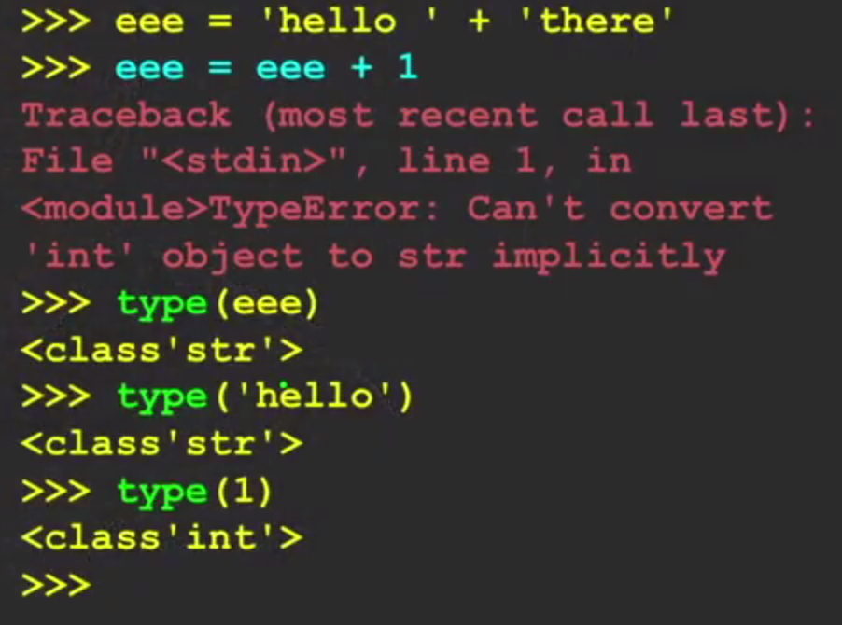
Type Matters
Python knows what type everything is
Some operations are prohibited
You cannot add 1 to a string
We can ask Python what type a variable or input is using the type() function
Python is lost!

Slide 29
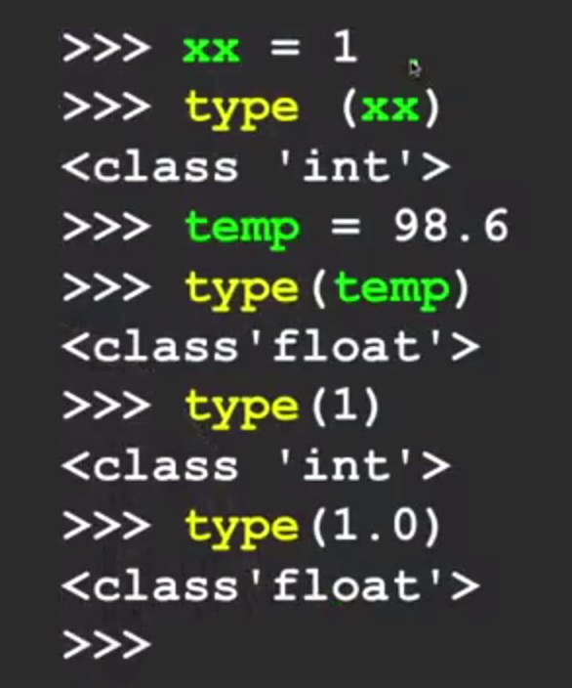
Several Types of Numbers
Two main types
Integers are whole numbers (integers are limited)
-14, -2, 0, 1, 2, 29, 120
Floating numbers include decimal parts: (more precise & more range)
-2.5, 0.0, 0.9, 1.4, 10.9, 109.45

Slide 30
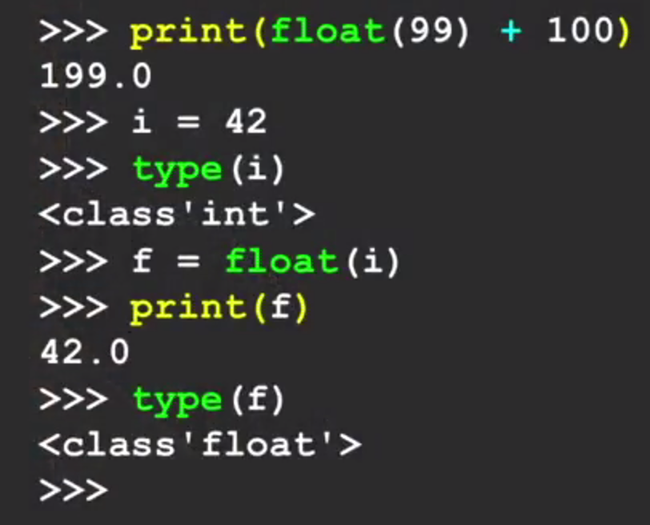
Type Conversions
When you put an integer and floating point in an expression, the integer is implicitly converted to a float
You can control this using built-in functions:
int()
float()

Slide 31
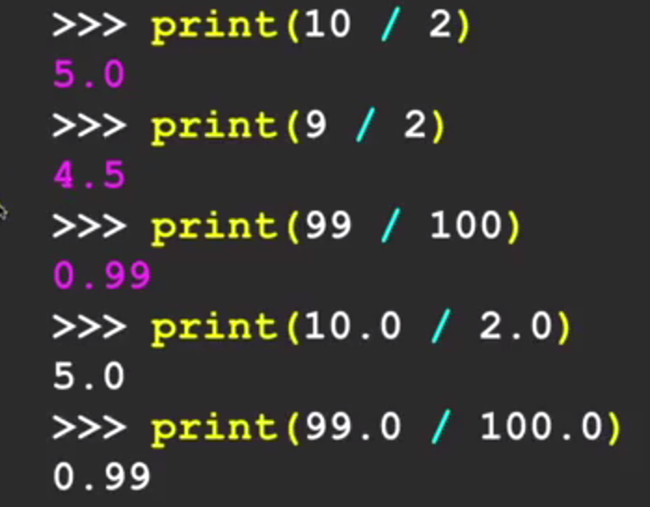
Integer Division
In Python, integer division produces a floating point result
In other programming languages such as Java, type needs to be specified
Note, integer division was different in Python 2.x

Slide 32
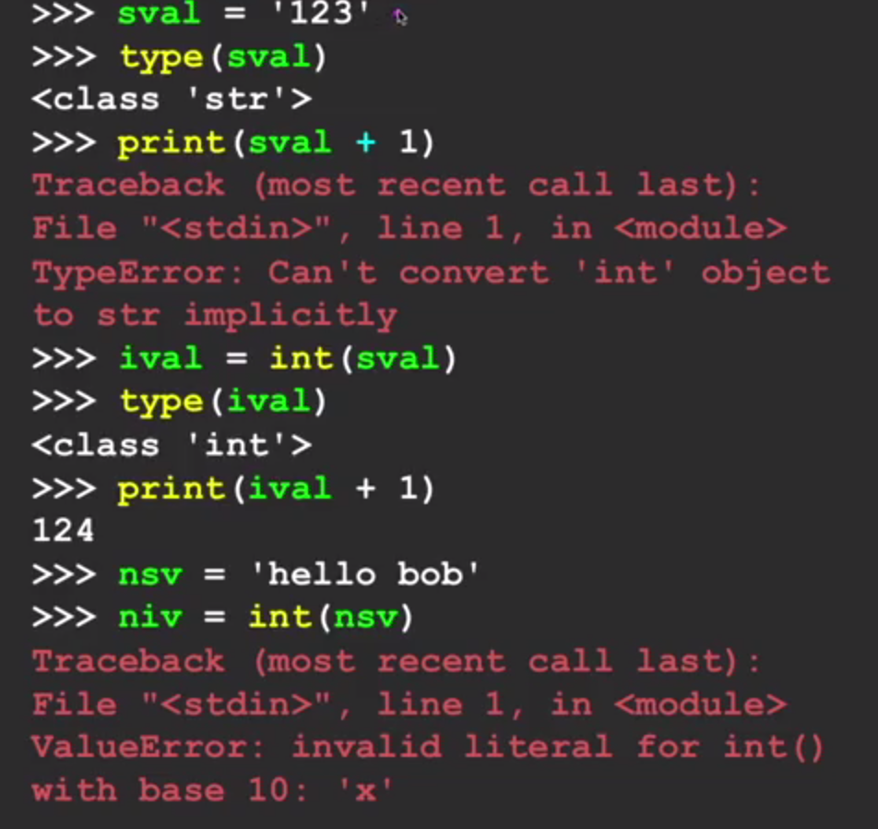
String Conversion
You can also use int() and float() to convert to string
You will get an error if the string does not contain numeric characters

Slide 33
Data Inputs
In Python, if we read data from an outside source such as reading from a text file, database or any other source, data will be in strings
Thus, conversions are needed

Slide 34
User Input
We can instruct Python to pause and read data from the user using the input() function
The input function returns a string

Slide 35
Comments
Anything after # is ignored by Python
Why comments?
Describe what is going to happen in a sequence of code
Document who wrote the code or other ancillary information
Turn off a line of code – perhaps temporarily
Oh! Thanks god! I commented this code, so now, I remember what it does

Slide 36
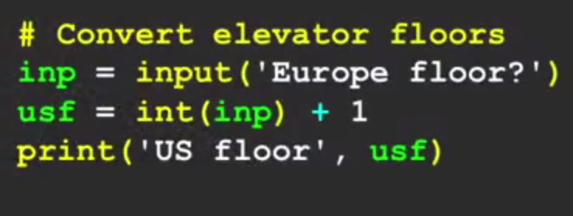
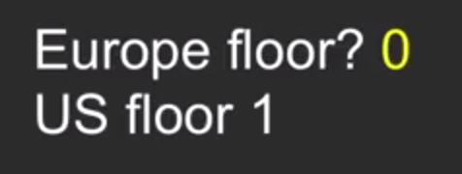
Our First Program - Converting User Input
If we want to read a number from the user, we must convert it from a string to a number/numerical type using conversion function
Later, we will deal with incorrect input data
Floors in the EU start with 0 or Ground whereas in the US, floors start with 1

Slide 37
Live Demo
Chapter 2

