Slide 1
Introduction to Computer Science
Programming with Python

Slide 2
Functions
Chapter 4

Slide 3
Summary
Sequential
Conditional
Store & Reuse
Iteration

Slide 4
Store & Reuse / Functions
Programmers do not like to repeat themselves
Avoid Redundant lines of code
If we have to use the same lines of code multiple times, we can store it in a function, and re-use it without re-typing the same lines of code
Functions are where we store code that we need to re-use
Functions can be used for other purposes, such as Object Oriented Programming, helper functions, more efficient code, and many others. For now, lets focus on store & reuse to avoid redundant code PyCharm does not like redundancy, and, it will warn you for repeated lines
Remember indentations code blocks. Code that belongs to a function must be intended to let the compiler know that, these lines of code inside the function

Slide 5
Functions

Slide 6
Functions
First, we call the function
Second, the function will execute its statements (print)

Slide 7
Functions
Argument
What is the expected output?

Slide 8
Functions
What is the expected output?

Slide 9
Max and Min Functions
Space is the smallest thing
Lower case is always first. E.g., y is greater than Y. According to the ASCII table
maximum_number = max(”1234”)
Output is 4
maximum_letter = max(“xyz XYZ”)
Output is z
maximum_letter = max(“XYZ XYZ”)
Z
minimum_letter = min(“Hello World”)
Output is
minimum_letter = min(“Hello World”)
Output is H
minimum_number = min(“1234)
Output is 1

Slide 10
Functions

Slide 17
Building our Own Functions
We create a new function using the def keyword followed by optional parameters in parentheses
We indent the body of the function
def defines the function but does not execute the body of the function

Slide 18
The def statement does not automatically run the code

Slide 19
The def statement does not automatically run the code
We must invoke

Slide 21
Arguments STOP HERE
An argument is a value we pass into the function as its input when we call the function
We use arguments so we can direct the function to do different kinds of work when we call it at different times
We put the arguments in parentheses after the name of the function
We can pass more than 1 argument by separating them using a comma
def any_given_name(argument1, argument2):
big = max(‘Hello world’)

Slide 22
Parameters

Slide 23
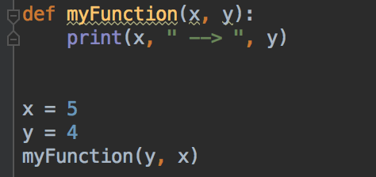
Parameters
Arguments will pass to the first alias, name is not important
Order of parameters matter but names do not
What is the expected output?

Slide 24
Parameters
Arguments will pass to the first Alias, name is not important
Order of parameters matter but names do not
What is the expected output?
4 --> 5

Slide 25
Parameters
Arguments will pass to the first Alias, name is not important
Order of parameters matter but names do not
What is the expected output?
4 --> 5
What if I invoke with a missing parameter, e.g., myFunction(x)?

Slide 26
Parameters
Arguments will pass to the first Alias, name is not important
Order of parameters matter but names do not
What is the expected output?
4 --> 5
What if I invoke with a missing parameter, e.g., myFunction(x)? Compiler error
This is because myFunction is expecting 2 arguments. Tip, we can pass an empty parameter such 0 or “” for strings

Slide 27
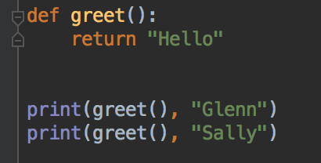
Return Values
Often a function will take its arguments, do some computation, and return a value to be used as the value of the function call in the calling expressions. The return keyword is used for this.
What is the expected output?

Slide 28
Return Values
Often a function will take its arguments, do some computation, and return a value to be used as the value of the function call in the calling expressions. The return keyword is used for this.
What is the expected output?

Slide 29
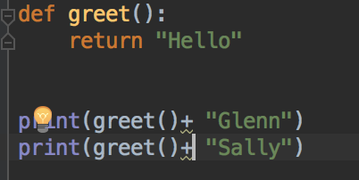
Return Values
Often a function will take its arguments, do some computation, and return a value to be used as the value of the function call in the calling expressions. The return keyword is used for this.
What is the expected output?

Slide 30
Return Values
Often a function will take its arguments, do some computation, and return a value to be used as the value of the function call in the calling expressions. The return keyword is used for this.
What is the expected output?

Slide 31
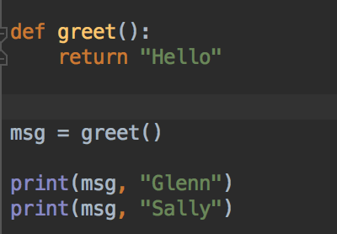
Return Values
We also can assign return values by functions to variables

Slide 32
Return Values

Slide 35
When you start coding and implementing large programs, and you are able to write/use functions effectively, it will come up in your mind, oooh! I can use a function here to avoid redundancy or for a more efficient code

