Slide 1
Introduction to Computer Science
Programming with Python

Slide 2
Data Structures - Strings
Chapter 6

Slide 3
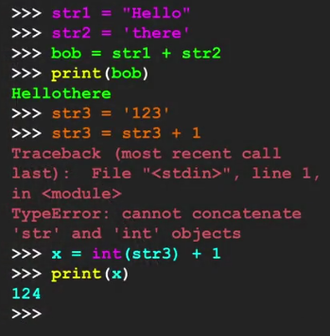
String Data Type
A string is a sequence of characters
A string literal uses quotes ‘Hello’ or “Hello”
For strings, + means concatenate
When a string contains numbers, it is still a string
We can convert numbers in a string into a number (integer/float) using int()

Slide 4
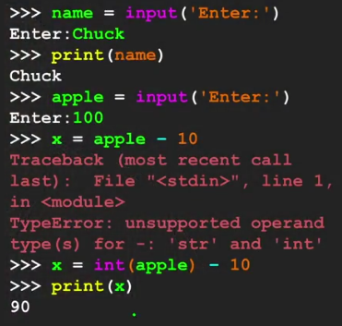
Reading and Converting
We prefer to read data in using strings and then parse and convert the data as we need
This gives us more control over error situations and/or bad user input
Input numbers must be converted from strings

Slide 5
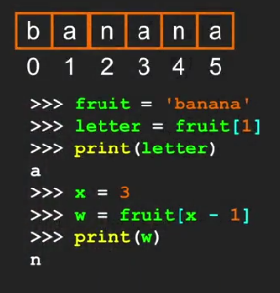
Looking Inside Strings
We can get any single character in a string using an index specified in square brackets
The index value must be an integer and starts at zero
The index value can be an expression that is computer

Slide 6
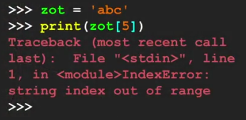
A Character Too Far
You will get a Python error if you attend to index beyond the end of a string
So, be careful when constructing index values and slices

Slide 7
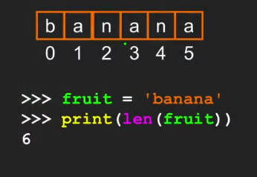
Length of a String
The built-in function len gives us the length of a string

Slide 8
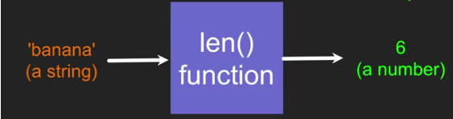
Len Function
A function is some stored code that we use. A function takes some input and produce an output

Slide 9
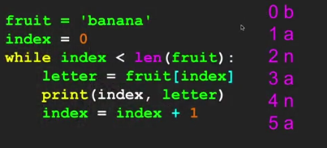
Looping Through Strings
Using a while statement and an iteration variable, and the len function, we can construct a loop to look at each of the letters in a string individually

Slide 10
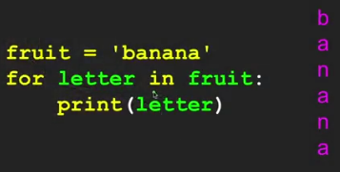
Looping Through Strings
A definite loop using a for statement is much more elegant
The iteration variable is completely taken care of by the for loop

Slide 11
Looping Through Strings
A definite loop using a for statement is much more elegant
The iteration variable is completely taken care of by the for loop
This is the Pythonic way. Translate that to classic for loops that are common in other/most programming languages

Slide 12
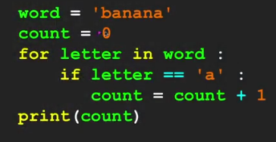
Looping and Counting
This is a simple loop that loops through each letter in a string and counts the number of times the encounters the ‘a’ character

Slide 13
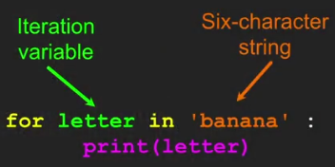
Looking Deeper into in
The iteration variable iterates through the sequence (ordered set)
The block (body) of code is executed once for each value in the sequence
The iteration variable moves through all of the values in the sequence

Slide 14
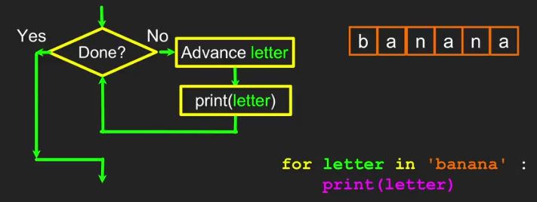
Looping through a string – for loop
The iteration variable iterates through the string and the block (body) of code is executed once for each value in the sequence

Slide 15
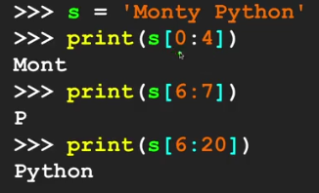
Slicing Strings
It is possible to look at any continuous section of a string using a colon separator
Example, [ from : to]
The second number is one beyond the end of the slice up to but not including
If the second number is beyond the end of string, it stops at the end

Slide 16
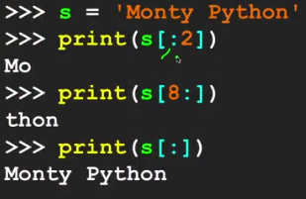
Slicing Strings
If we leave off the first number or the last number of the slice, it is assumed to be the beginning or end of the string respectively

Slide 17
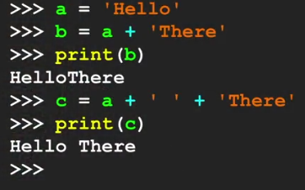
String Concatenation
When the + operator is applied to strings, it means concatenation

Slide 18
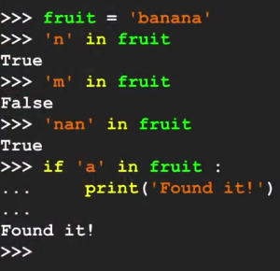
Using in as a Logical Operator
The in keyword can also be used to check to see if one string is “in” another string
The in expressions is a logical expression that returns True or False and can be used in an if statement

Slide 19
String Comparison

Slide 20
String Comparison
A < a
z < a

Slide 21
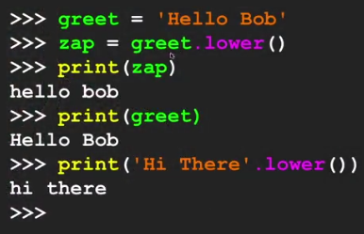
String Library
Python has a number of string functions which are in the string library
These functions are already built into every string. We invoke them by appending the function to the string variable
These functions do not modify the original string, instead they return a new string that has been altered

Slide 22
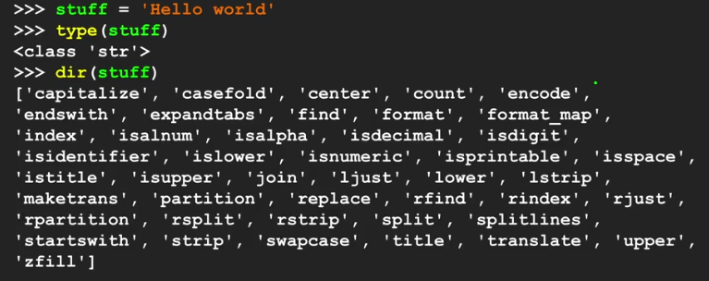
https://docs.python.org/3/library/stdtypes.html#string-methods

Slide 23
String Library

Slide 24
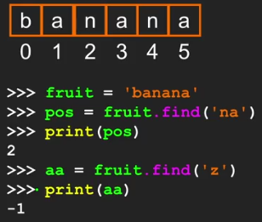
Searching a String
We use the find() function to search for a substring within another string
find() finds the first occurrence of the substring
If the substring is not found, find() returns -1
Remember that string position starts at zero

Slide 25
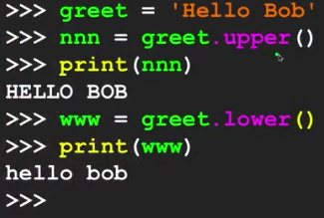
Making Everything UPPER CASE
You can make a copy of a string in lower case or upper case
Often when we are searching for a string using find() we first convert the string to lower case so we can search a string regardless of case

Slide 26
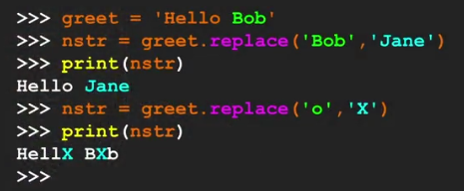
Search and Replace
The replace() function is like a search and replace operation in a word processor
It replaces all occurrences of the search string with the replacement string

Slide 27
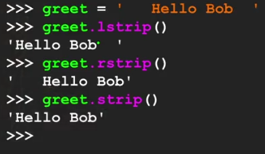
Stripping Whitespace
Sometimes we want to take a string and remove whitespace at the beginning and/or end
lstrip() and rstrip() remove whitespaces at the left or right
strip() removes both beginning and ending whitespace

Slide 28
Prefixes

Slide 29
Parsing and Extracting
From Stephen.marquard@uct.ac.za Sat Jan 5 09:14:16 2008 21 31

Slide 30
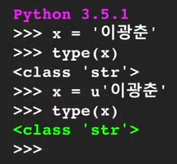
Strings and Character Set
In Python3, all strings are Unicode

Slide 31
Summary
String type
Read/Convert
Indexing []
Slicing string [2:4]
Looping through string with for and while
Concatenating string with +
String operations
String library
String Comparisons
Searching in strings
Replacing text
Stripping white space

