Slide 1
CHAPTER 6 - Database Implementation and Use
Database Systems -
Introduction to Databases and Data Warehouses

Slide 2
REFERENTIAL INTEGRITY CONSTRAINT
Referential integrity constraint - In each row of a relation containing a foreign key, the value of the foreign key EITHER matches one of the values in the primary key column of the referred relation OR the value of the foreign key is null (empty).
Regulates the relationship between a table with a foreign key and a table with a primary key to which the foreign key refers
Jukić, Vrbsky, Nestorov – Database Systems
Chapter 6 – Slide 2

Slide 3
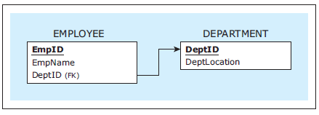
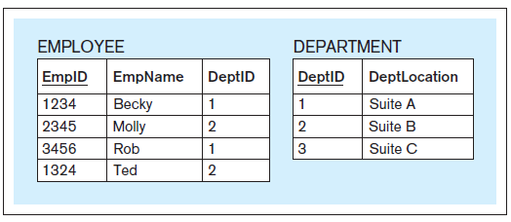
REFERENTIAL INTEGRITY CONSTRAINT
Referential integrity constraint compliance example
Two relations and a referential integrity constraint
Data records in compliance with the referential integrity constraint
Jukić, Vrbsky, Nestorov – Database Systems
Chapter 6 – Slide 3
Notes:
3

Slide 4
REFERENTIAL INTEGRITY CONSTRAINT: DELETE AND UPDATE IMPLEMENTATION OPTIONS
Referential integrity constraint - delete and update implementation options
Delete options
DELETE RESTRICT
DELETE CASCADE
DELETE SET-TO-NULL
DELETE SET-TO-DEFAULT
Update options
UPDATE RESTRICT
UPDATE CASCADE
UPDATE SET-TO-NULL
UPDATE SET-TO-DEFAULT
Jukić, Vrbsky, Nestorov – Database Systems
Chapter 6 – Slide 4
Notes:
4

Slide 5
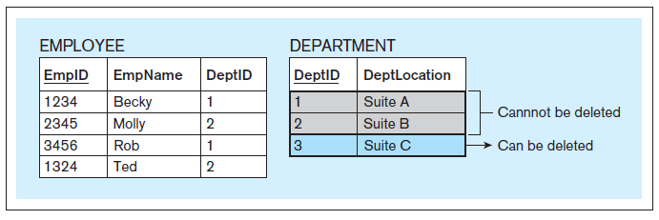
REFERENTIAL INTEGRITY CONSTRAINT: DELETE AND UPDATE IMPLEMENTATION OPTIONS
DELETE RESTRICT example
Chapter 6 – Slide 5
Notes:
5

Slide 6
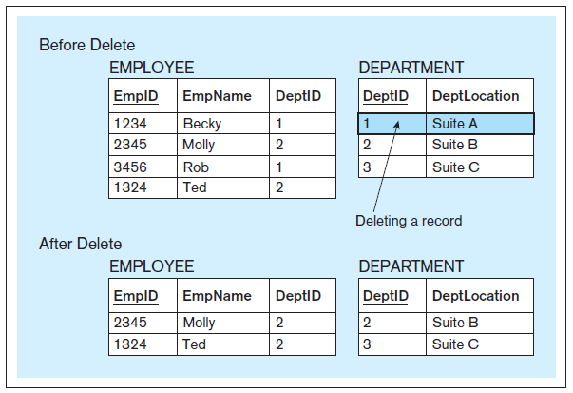
REFERENTIAL INTEGRITY CONSTRAINT: DELETE AND UPDATE IMPLEMENTATION OPTIONS
DELETE CASCADE example
Chapter 6 – Slide 6
Notes:
This example is discussed on Pages 178-179.
6

Slide 7
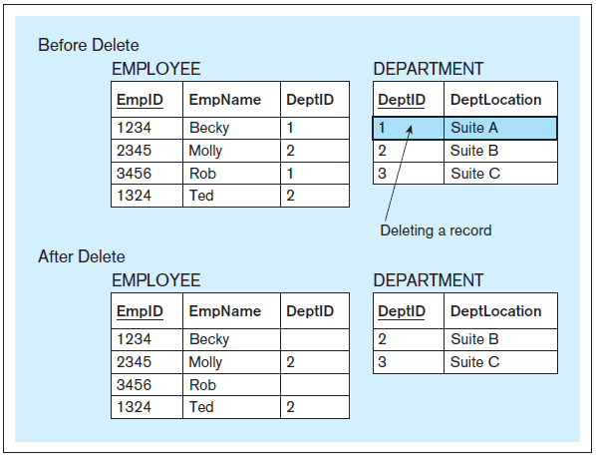
REFERENTIAL INTEGRITY CONSTRAINT: DELETE AND UPDATE IMPLEMENTATION OPTIONS
DELETE SET-TO-NULL example
Chapter 6 – Slide 7
Notes:
This example is discussed on Page 181.
7

Slide 8
REFERENTIAL INTEGRITY CONSTRAINT: DELETE AND UPDATE IMPLEMENTATION OPTIONS
DELETE SET-TO-DEFAULT example
Chapter 6 – Slide 8
Notes:
This example is discussed on Page 180.
8

Slide 9
REFERENTIAL INTEGRITY CONSTRAINT: DELETE AND UPDATE IMPLEMENTATION OPTIONS
UPDATE RESTRICT example
Chapter 6 – Slide 9
Notes:
This example is discussed on Pages 180-181.
9

Slide 10
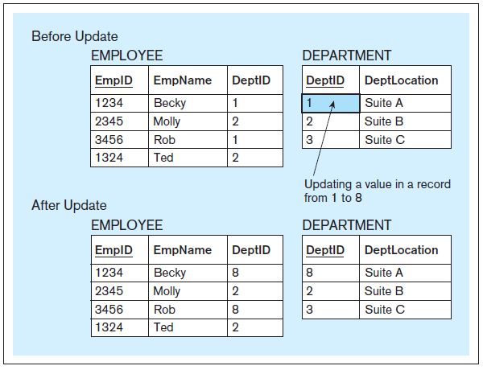
REFERENTIAL INTEGRITY CONSTRAINT: DELETE AND UPDATE IMPLEMENTATION OPTIONS
UPDATE CASCADE example
Chapter 6 – Slide 10
Notes:
This example is discussed on Pages 178-179.
10

Slide 11
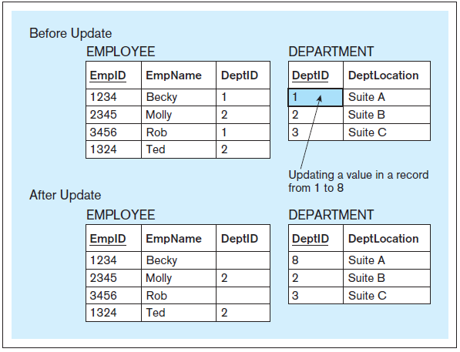
REFERENTIAL INTEGRITY CONSTRAINT: DELETE AND UPDATE IMPLEMENTATION OPTIONS
UPDATE SET-TO-NULL example
Chapter 6 – Slide 11
Notes:
This example is discussed on Page 181.
11

Slide 12
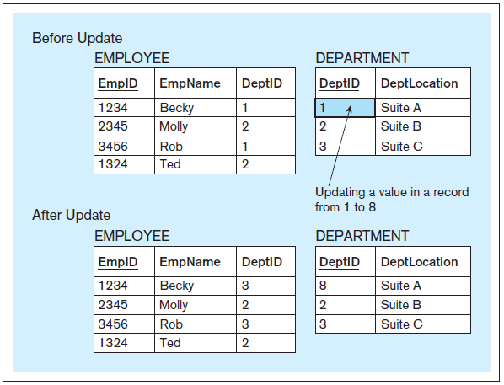
REFERENTIAL INTEGRITY CONSTRAINT: DELETE AND UPDATE IMPLEMENTATION OPTIONS
UPDATE SET-TO-DEFAULT example
Chapter 6 – Slide 12
Notes:
This example is discussed on Pages 182-183.
12

Slide 13
REFERENTIAL INTEGRITY CONSTRAINT: DELETE AND UPDATE IMPLEMENTATION OPTIONS
Implementing delete and update options
Example - DELETE RESTRICT and UPDATE RESTRICT CREATE TABLE employee ( empid CHAR(4), empname CHAR(20), deptid CHAR(2), PRIMARY KEY (empid), FOREIGN KEY (deptid) REFERENCES department);
Jukić, Vrbsky, Nestorov – Database Systems
Chapter 6 – Slide 13
Notes:
This example is discussed on Pages 183-184.
13

Slide 14
REFERENTIAL INTEGRITY CONSTRAINT: DELETE AND UPDATE IMPLEMENTATION OPTIONS
Implementing delete and update options
Example - DELETE CASCADE CREATE TABLE employee ( empid CHAR(4), empname CHAR(20), deptid CHAR(2), PRIMARY KEY (empid), FOREIGN KEY (deptid) REFERENCES department ON DELETE CASCADE);
Jukić, Vrbsky, Nestorov – Database Systems
Chapter 6 – Slide 14
Notes:
14

Slide 15
REFERENTIAL INTEGRITY CONSTRAINT: DELETE AND UPDATE IMPLEMENTATION OPTIONS
Implementing delete and update options
Example – UPDATE SET-TO-NULL CREATE TABLE employee ( empid CHAR(4), empname CHAR(20), deptid CHAR(2), PRIMARY KEY (empid), FOREIGN KEY (deptid) REFERENCES department ON UPDATE SET NULL);
Jukić, Vrbsky, Nestorov – Database Systems
Chapter 6 – Slide 15
Notes:
This example is discussed on Page 184.
15

Slide 16
REFERENTIAL INTEGRITY CONSTRAINT: DELETE AND UPDATE IMPLEMENTATION OPTIONS
Implementing delete and update options
Example - DELETE CASCADE and UPDATE SET-TO-NULL CREATE TABLE employee ( empid CHAR(4), empname CHAR(20), deptid CHAR(2), PRIMARY KEY (empid), FOREIGN KEY (deptid) REFERENCES department ON DELETE CASCADE ON UPDATE SET NULL);
Jukić, Vrbsky, Nestorov – Database Systems
Chapter 6 – Slide 16
Notes:
This example is discussed on Page 184.
16

Slide 17
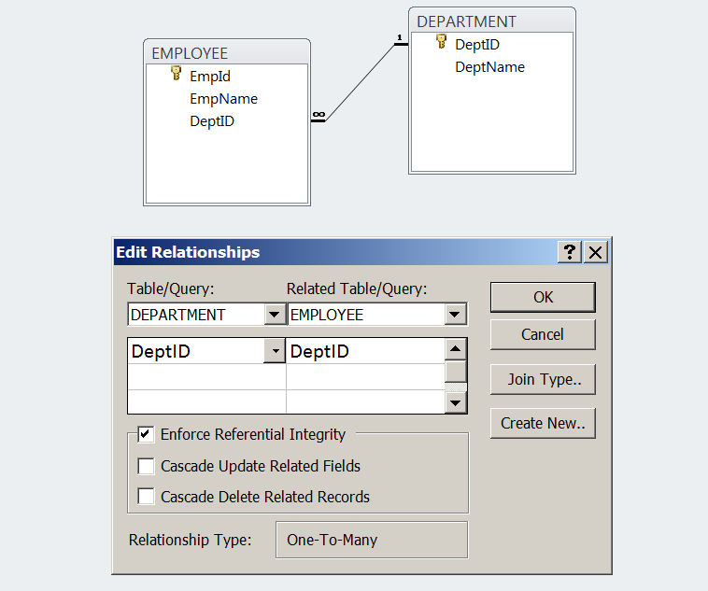
REFERENTIAL INTEGRITY CONSTRAINT: DELETE AND UPDATE IMPLEMENTATION OPTIONS
Implementing delete and update options
Example - DELETE RESTRICT and UPDATE RESTRICT (MS Access)
Jukić, Vrbsky, Nestorov – Database Systems
Chapter 6 – Slide 17
Notes:
This example is discussed on Page 184.
17

Slide 18
IMPLEMENTING USER-DEFINED CONSTRAINTS
Implementing user-defined constraints
Methods for implementing user-defined constraints include:
CHECK clause
Assertions and triggers
Coding in specialized database programming languages that combine SQL with additional non-SQL statements for processing data from databases (such as PL/SQL)
Embedding SQL with code written in regular programming languages (such as C++ or Java)
In many cases the logic of user-defined constraints is not implemented as a part of the database, but as a part of the front-end database application
Jukić, Vrbsky, Nestorov – Database Systems
Chapter 6 – Slide 18
Notes:
This example is discussed on Page 185.
18

Slide 19
IMPLEMENTING USER-DEFINED CONSTRAINTS
CHECK
Used to specify a constraint on a particular column of a relation
Jukić, Vrbsky, Nestorov – Database Systems
Chapter 6 – Slide 19
Notes:
This example is discussed on Page 185.
19

Slide 20
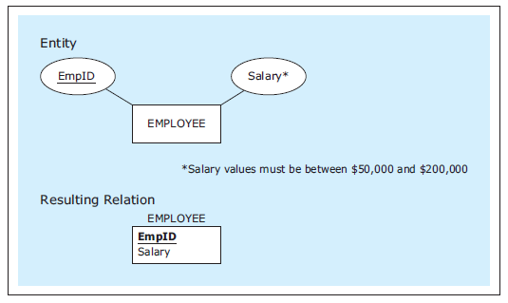
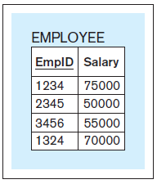
CHECK – Example 1
A relation with a user-defined constraint
CREATE TABLE employee
(empid CHAR(4),
salary NUMBER(6) CHECK (salary >= 50000 AND salary <= 200000),
PRIMARY KEY (empid));
INSERT INTO employee VALUES ('1234', 75000);
INSERT INTO employee VALUES ('2345', 50000);
INSERT INTO employee VALUES ('3456', 55000);
INSERT INTO employee VALUES ('1324', 70000);
INSERT INTO employee VALUES ('9876', 270000);
INSERT INTO employee VALUES ('1010', 30000);
SQL code
Four inserts accepted, two inserts rejected
Jukić, Vrbsky, Nestorov – Database Systems
Chapter 6 – Slide 20
Notes:
20

Slide 21
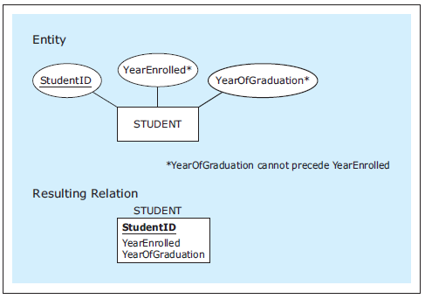
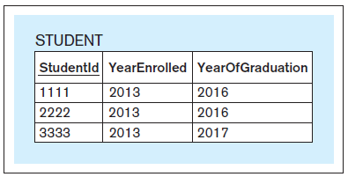
CHECK – Example 2
A relation with a user-defined constraint
CREATE TABLE student
(studentid CHAR(4),
yearenrolled INT,
yearofgraduation INT,
PRIMARY KEY (studentid), CHECK (yearenrolled <= yearofgraduation));
INSERT INTO student VALUES ('1111', 2012, 2016);
INSERT INTO student VALUES ('2222', 2013, 2017);
INSERT INTO student VALUES ('3333', 2013, 2017);
INSERT INTO student VALUES ('4444', 2013, 2012);
SQL code
Three inserts accepted, one insert rejected
Jukić, Vrbsky, Nestorov – Database Systems
Chapter 6 – Slide 21
Notes:
From the business use point of view, the enforcement of user-defined constraints is more important than which actual method of implementing the user-defined constraint was chosen. Often, when there is more than one method available, the choice is made based on technical considerations, such as which of the methods provides for the fastest execution.
21

Slide 22
IMPLEMENTING USER-DEFINED CONSTRAINTS
Implementing user-defined constraints
In many cases the logic of user-defined constraints is not implemented as a part of the database, but as a part of the front-end database application
For the proper use of the database, it is important that user-defined constraints are implemented fully
Jukić, Vrbsky, Nestorov – Database Systems
Chapter 6 – Slide 22
Notes:
22

Slide 23
Summary
Constraints on attributes:
NOT NULL – obvious
Check condition
Constraints on tuples
Check condition
Create table R(
A int NOTNULL
B int check B > 50 and B < 100
C varchar(20)
D int
Check ( C >= 'd' or D > 0)

Slide 24
INDEXING
INDEX - Mechanism for increasing the speed of data search and data retrieval on relations with a large number of records
Most relational DBMS software tools enable definition of indexes
Jukić, Vrbsky, Nestorov – Database Systems
Chapter 6 – Slide 24
Notes:
This example is discussed on Pages 185-186
24

Slide 25
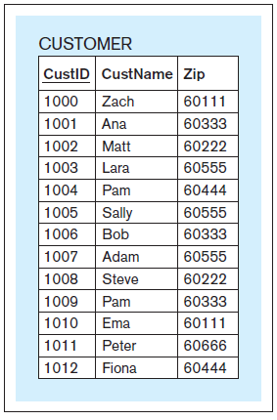
Conceptual simplified illustration of the principles on which an index is based Example relation
Jukić, Vrbsky, Nestorov – Database Systems
Chapter 6 – Slide 25
Notes:
This example is discussed on Pages 185-186
25

Slide 26
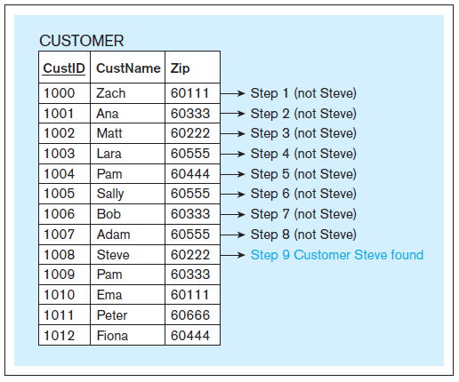
Conceptual simplified illustration of the principles on which an index is based Linear search - example
Jukić, Vrbsky, Nestorov – Database Systems
Chapter 6 – Slide 26
Notes:
This example is discussed on Pages 187-190
26

Slide 27
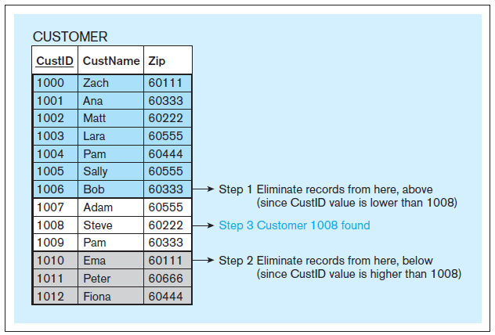
Conceptual simplified illustration of the principles on which an index is based Binary search - example
Jukić, Vrbsky, Nestorov – Database Systems
Chapter 6 – Slide 27
Notes:
This example is discussed on Pages 187-190
27

Slide 28
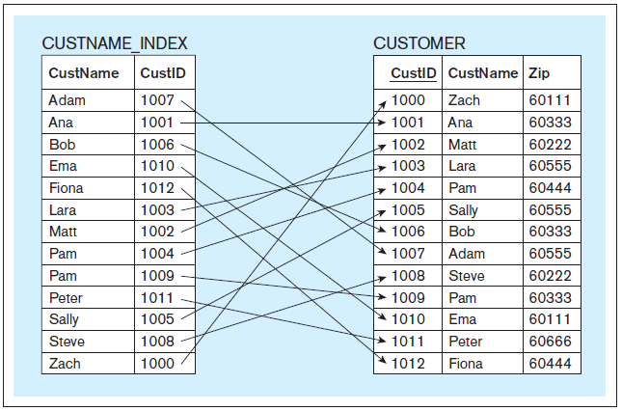
Conceptual simplified illustration of the principles on which an index is based Index - example
Jukić, Vrbsky, Nestorov – Database Systems
Chapter 6 – Slide 28
Notes:
This example is discussed on Pages 187-190
28

Slide 29
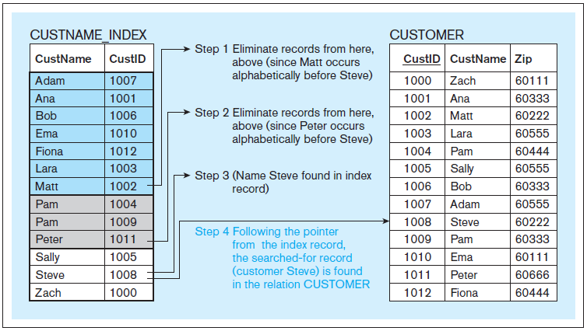
Conceptual simplified illustration of the principles on which an index is based Increased search speed using the index - example
Jukić, Vrbsky, Nestorov – Database Systems
Chapter 6 – Slide 29
Notes:
This example is discussed on Pages 187-190
29

Slide 30
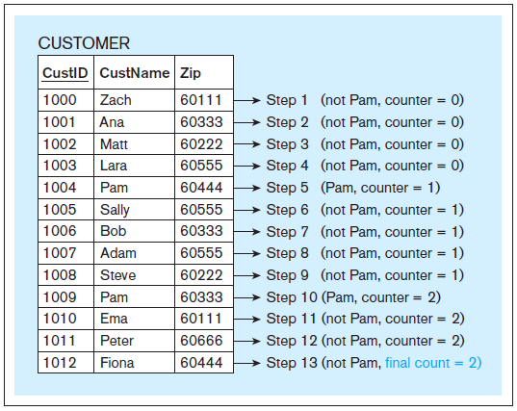
Conceptual simplified illustration of the principles on which an index is based Linear search – another example
Jukić, Vrbsky, Nestorov – Database Systems
Chapter 6 – Slide 30
Notes:
This example is discussed on Pages 187-190
30

Slide 31
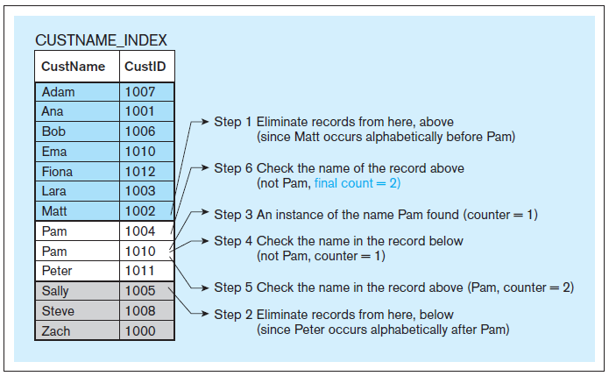
Conceptual simplified illustration of the principles on which an index is based Increased search speed using the index – another example
Jukić, Vrbsky, Nestorov – Database Systems
Chapter 6 – Slide 31
Notes:
This example is discussed on Pages 191-192
31

Slide 32
INDEXING
The preceding examples provided simplified conceptual illustration of the principles on which an index is based
Instead of simply sorting on the indexed column and applying binary search, different contemporary DBMS tools implement indexes using different logical and technical approaches, such as:
Clustering indexes
Hash indexes
B+ trees
etc.
Each of the available approaches has the same goal – increase the speed of search and retrieval on the columns that are being indexed
Jukić, Vrbsky, Nestorov – Database Systems
Chapter 6 – Slide 32
Notes:
This example is discussed on Pages 187-190
32

Slide 33
INDEXING
CREATE INDEX
Example: CREATE INDEX custname_index ON customer(custname);
Once this statement is executed, the effect is that the searches and retrievals involving the CustName column in the relation CUSTOMER are faster
DROP INDEX
Example: DROP INDEX custname_index ON customer(custname);
This statement drops the index, and the index is no longer used
Jukić, Vrbsky, Nestorov – Database Systems
Chapter 6 – Slide 33
Notes:
In the preceding examples, for the simplicity of illustration, we used the primary key value of the record as the index pointer. In practice the value of the index pointer can be a physical address of the record on the disk or some other mechanism that relates to the physical location of records
No matter what logical and technical approaches are used by the DBMS to implement the index, the main point is: when an index is created it improves the performance of data search and retrieval.
33

Slide 34
DATABASE FRONT-END
Database front-end
Provides access to the database for indirect use
Jukić, Vrbsky, Nestorov – Database Systems
Chapter 6 – Slide 34

Slide 35
DATABASE FRONT-END
Form
Enables data input and retrieval for end users
Provides an interface into a database relation or query
Jukić, Vrbsky, Nestorov – Database Systems
Chapter 6 – Slide 35
Notes:
35

Slide 36
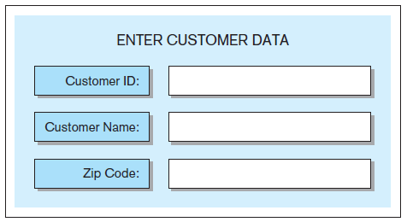
Form – Example 1
SQL code generated:
INSERT INTO customer VALUES (…)
Jukić, Vrbsky, Nestorov – Database Systems
Chapter 6 – Slide 36
Notes:
In most cases, a portion of intended users (often a majority of the users) of the database lack the time and/or expertise to engage in the direct use of the data in the database. It is not reasonable to expect every person who needs to use the data from the database to write his or her own queries and other statements.
36

Slide 37
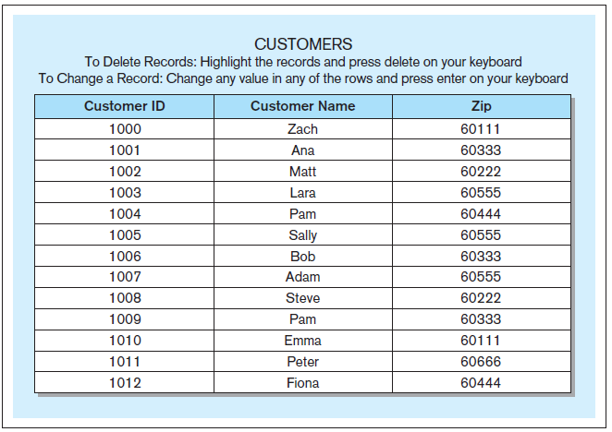
Form – Example 2
Sample SQL code generated:
DELETE FROM customer WHERE custid = '1012';
UPDATE customer
SET custname = 'Zachary'
WHERE custid = '1000';
Jukić, Vrbsky, Nestorov – Database Systems
Chapter 6 – Slide 37
Notes:
37

Slide 38
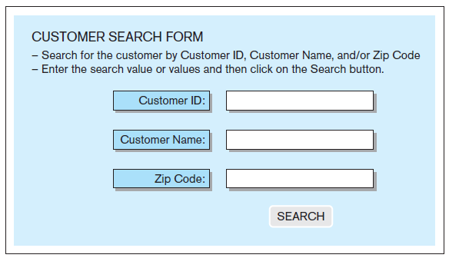
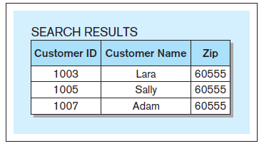
Form – Example 3
Sample SQL code generated:
SELECT * FROM customer WHERE zip = '60555';
Jukić, Vrbsky, Nestorov – Database Systems
Chapter 6 – Slide 38
Notes:
This example is discussed on Pages 192-193
38

Slide 39
DATABASE FRONT-END
Report
Presents the data and calculations on the data from one or more tables from the database in a formatted way
The data that is retrieved via reports is formatted and arranged to be displayed on the screen or printed as a hard copy
Jukić, Vrbsky, Nestorov – Database Systems
Chapter 6 – Slide 39
Notes:
This example is discussed on Page 193
39

Slide 40
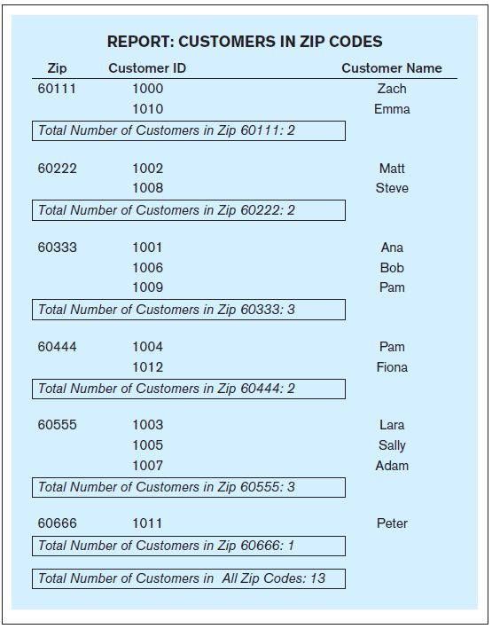
Report – Example
Jukić, Vrbsky, Nestorov – Database Systems
Chapter 6 – Slide 40
Notes:
This example is discussed on Pages 193-194
40

Slide 41
DATABASE FRONT-END
In addition to the forms and reports, database front-end applications can include many other components and functionalities, such as:
menus
charts
graphs
maps
etc.
The choice of how many different components to use and to what extent is driven by the needs of the end-users
A database can have multiple sets of front-end applications for different purposes or groups of end-users
Jukić, Vrbsky, Nestorov – Database Systems
Chapter 6 – Slide 41
Notes:
41

Slide 42
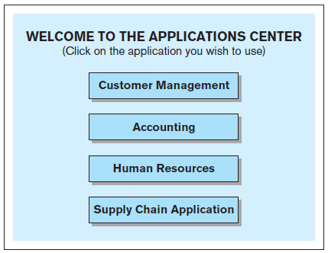
Front-end interface – Example An example of an interface to a collection of database front-end applications
Jukić, Vrbsky, Nestorov – Database Systems
Chapter 6 – Slide 42
Notes:
This example is discussed on Pages 194-195
42

Slide 43
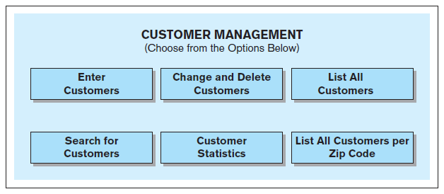
Front-end interface – Example An example of an interface to a database front-end application
Jukić, Vrbsky, Nestorov – Database Systems
Chapter 6 – Slide 43
Notes:
Front-end applications can be accessible separately on their own or via an interface that allows the user to choose an application that they need.
43

Slide 44
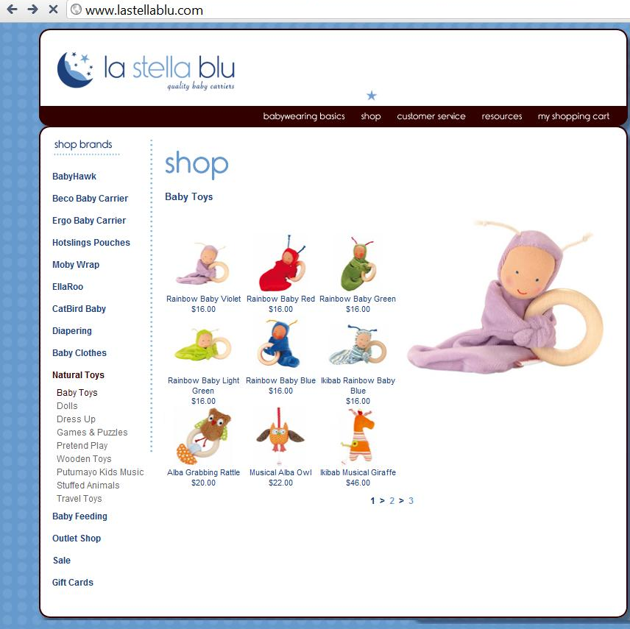
Web page - Example
Jukić, Vrbsky, Nestorov – Database Systems
Chapter 6 – Slide 44
Notes:
This example is discussed on Pages 195-196
44

Slide 45
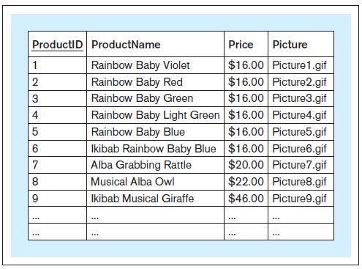
Web page - Example A database relation storing the content of the Web site
Jukić, Vrbsky, Nestorov – Database Systems
Chapter 6 – Slide 45
Notes:
This example is discussed on Pages 196-197
45

Slide 46
DATA QUALITY
Data quality
The data in a database is considered of high quality if it correctly and non-ambiguously reflects the real-world it is designed to represent
Data quality characteristics
Accuracy
Uniqueness
Completeness
Consistency
Timeliness
Conformity
Jukić, Vrbsky, Nestorov – Database Systems
Chapter 6 – Slide 46
Notes:
This example is discussed on Pages 196-197
46

Slide 47
DATA QUALITY
Accuracy - the extent to which data correctly reflects the real-world instances it is supposed to depict
Jukić, Vrbsky, Nestorov – Database Systems
Chapter 6 – Slide 47
Notes:
47

Slide 48
DATA QUALITY
Uniqueness - requires each real-world instance to be represented only once in the data collection
The uniqueness data quality problem is sometimes also referred to as data duplication
Jukić, Vrbsky, Nestorov – Database Systems
Chapter 6 – Slide 48
Notes:
Example given on Page 197.
48

Slide 49
DATA QUALITY
Completeness - the degree to which all the required data is present in the data collection
Jukić, Vrbsky, Nestorov – Database Systems
Chapter 6 – Slide 49
Notes:
Example given on Page 198.
49

Slide 50
DATA QUALITY
Consistency - the extent to which the data properly conforms to and matches up with the other data
Jukić, Vrbsky, Nestorov – Database Systems
Chapter 6 – Slide 50
Notes:
Example given on Page 198.
50

Slide 51
DATA QUALITY
Timeliness - the degree to which the data is aligned with the proper time window in its representation of the real world
Typically, timeliness refers to the “freshness” of the data
Jukić, Vrbsky, Nestorov – Database Systems
Chapter 6 – Slide 51
Notes:
Examples given on Page 198.
51

Slide 52
DATA QUALITY
Conformity - the extent to which the data conforms to its specified format
Jukić, Vrbsky, Nestorov – Database Systems
Chapter 6 – Slide 52
Notes:
Example given on Page 198.
52

Slide 53
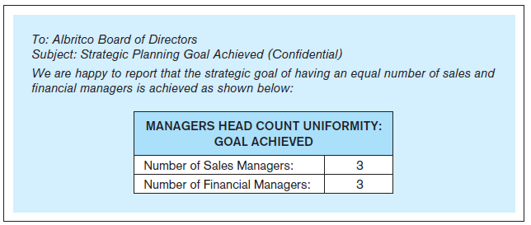
Data quality – Example A message reporting the head count of the managers in the Albritco company
Jukić, Vrbsky, Nestorov – Database Systems
Chapter 6 – Slide 53
Notes:
Example given on Pages 198-199.
53

Slide 54
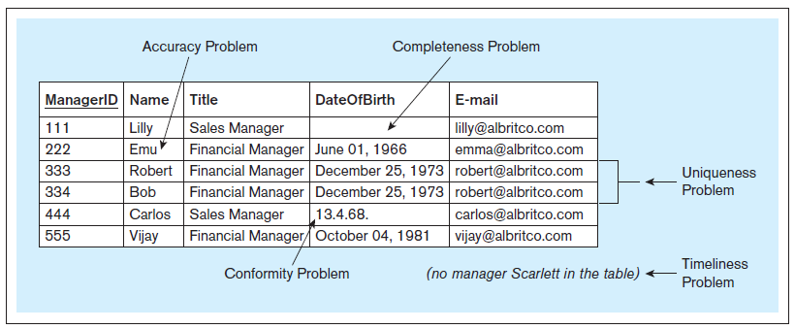
Data quality – Example Albritco database relation with data quality issues
Jukić, Vrbsky, Nestorov – Database Systems
Chapter 6 – Slide 54
Notes:
This example is discussed on Pages 199-202.
54

Slide 55
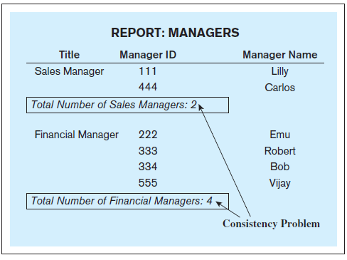
Data quality – Example A report based on the Albritco relation with data quality issues
Jukić, Vrbsky, Nestorov – Database Systems
Chapter 6 – Slide 55
Notes:
This example is discussed on Pages 199-202.
55

Slide 56
DATA QUALITY
Preventive data quality actions
Actions taken to preclude data quality problems
Corrective data quality actions
Actions taken to correct the data quality problems
Jukić, Vrbsky, Nestorov – Database Systems
Chapter 6 – Slide 56
Notes:
Examples of preventive and corrective data quality actions are given on Pages 200-201.
56

Slide 57
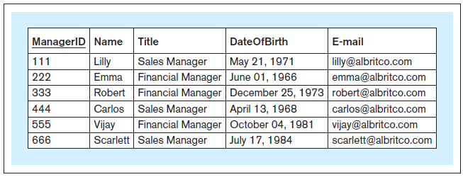
Data quality – Example Albritco database relation with the data quality issues resolved
Jukić, Vrbsky, Nestorov – Database Systems
Chapter 6 – Slide 57
Notes:
This example is discussed on Pages 199-202.
57

Slide 58
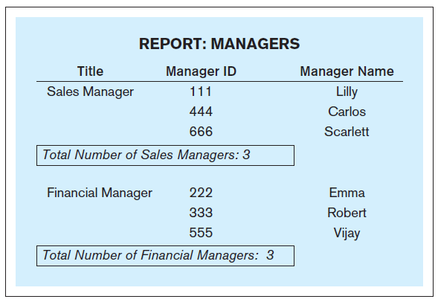
Data quality – Example A report based on the Albritco relation with the data quality issues resolved
Jukić, Vrbsky, Nestorov – Database Systems
Chapter 6 – Slide 58

