Slide 1
Database Management Systems
DBMS

Slide 2
SQL – Stored Procedures

Slide 3
What is a Stored Procedure?
A stored procedure is similar to functions in programming languages
A stored procedure is a prepared SQL code that you can save code and re-use
So, if you have an SQL query that you write over and over again, save it as a stored procedure, and then just call it to execute it
You can also pass parameters to a stored procedure, so that the stored procedure can act based on the parameter value(s) that is passed.

Slide 4
Syntax
USE `paper_reviews`; DROP procedure IF EXISTS `getAllPapers`; DELIMITER $$ USE `paper_reviews`$$ CREATE PROCEDURE `getAllPapers` () BEGIN select * from paper; END $$ DELIMITER ;

Slide 5
Procedure that takes parameters
USE `paper_reviews`; DROP procedure IF EXISTS `checkIfPaperExist`; DELIMITER $$ USE `paper_reviews`$$ CREATE PROCEDURE `checkIfPaperExist` (IN PaperID INT) BEGIN IF exists (select pid from paper_reviews.paper where paper.pid = PaperID) THEN select "paper exists"; ELSE select "paper does not exist"; end if; END $$ DELIMITER ;

Slide 6
Execute/Call a Stored Procedure
Test that the stored procedure works as expected by typing the following into the mysql command interpreter:
CALL getAllPapers(); -→ Without argument
CALL checkIfPaperExist(1245); → With argument

Slide 7
Dev MySQL
https://dev.mysql.com/doc/connector-net/en/connector-net-tutorials-stored-procedures.html

Slide 8
Show All Stored Procedures
SHOW PROCEDURE STATUS WHERE Db = DATABASE() AND Type = 'PROCEDURE’;
This will return all stored procedures in the currently used database
Or,
show procedure status;
SHOW PROCEDURE STATUS WHERE Db = 'databasename';

Slide 9
More Samples
Access the GitHub Repo used for this course for more samples
https://github.com/sju-students-spring2019-dbms/DBMS/tree/master/StoredProcedures

Slide 10
Variables
DECLARE total_sale INT DEFAULT 0;
DECLARE x, y INT DEFAULT 0;
Assigning variables - Once you declared a variable, you can start using it. To assign a variable another value, you use the SET statement
DECLARE total_count INT DEFAULT 0;
SET total_count = 10;
The value of the total_count variable is 10 after the assignment

Slide 11
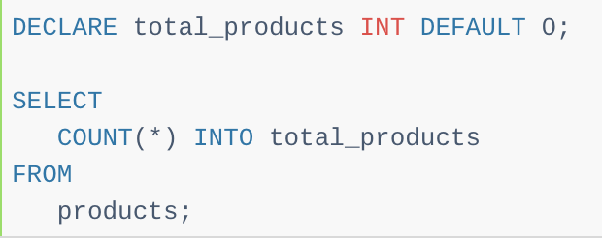
Variables
Besides the SET statement, you can use the SELECT INTO statement to assign the result of a query
Which returns a scalar value, to a variable
First, we declared a variable named total_products and initialized its value to 0
Then, we used the SELECT INTO statement to assign the total_products variable the number of products that we selected from the products table

Slide 12
MySQL Loop in Stored Procedures
MySQL provides loop statements that allow you to execute a block of SQL code repeatedly based on a condition
WHILE expression DO
statements
END WHILE

Slide 13
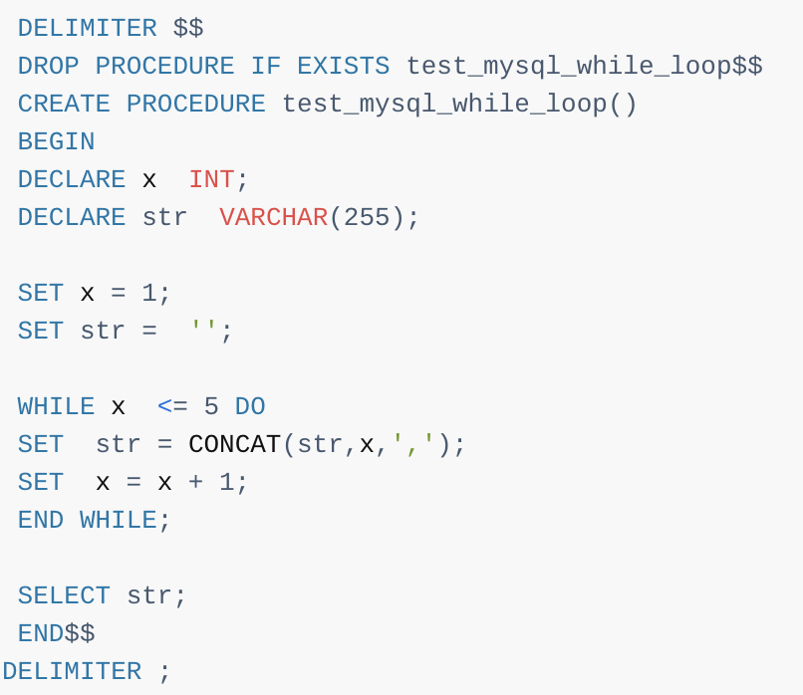
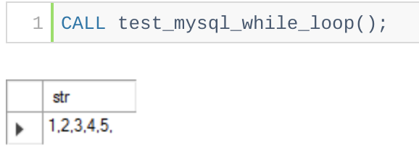

Slide 14
MySQL Procedure that Returns Multiple Values
MySQL stored function returns only one value
To develop stored programs that return multiple values, you need to use stored procedures with OUT parameters

Slide 15
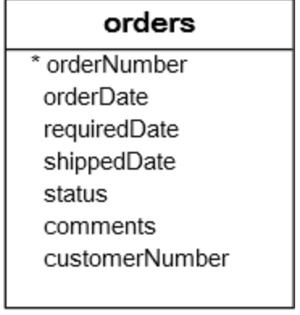
MySQL Procedure that Returns Multiple Values
The following stored procedure accepts customer number and returns the total number of orders that were shipped, canceled, resolved, and disputed.

Slide 16
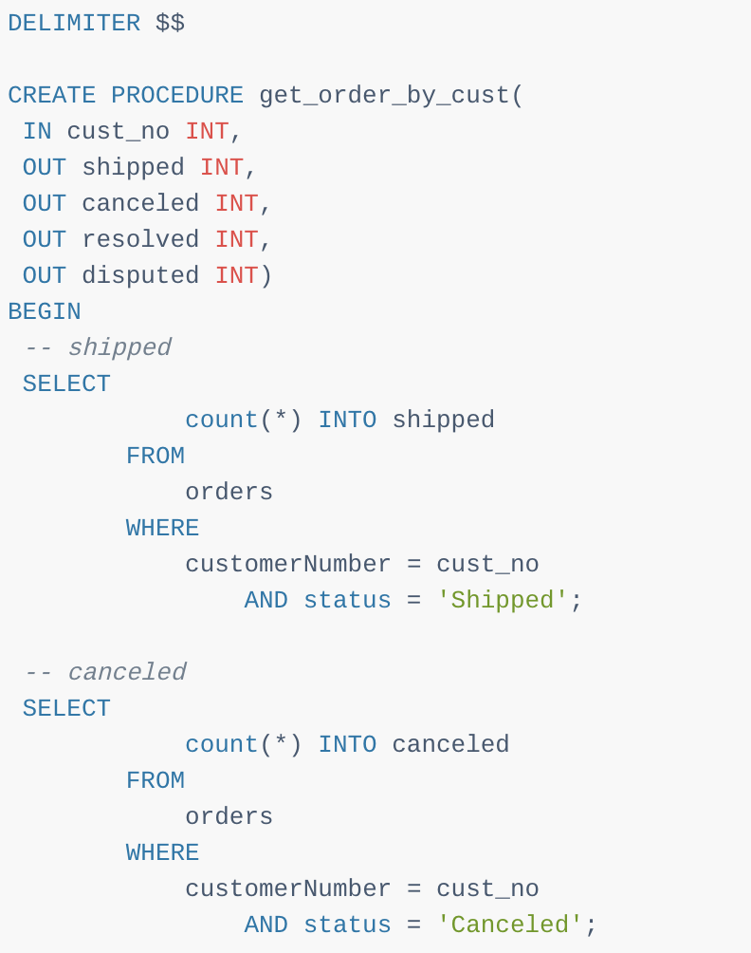
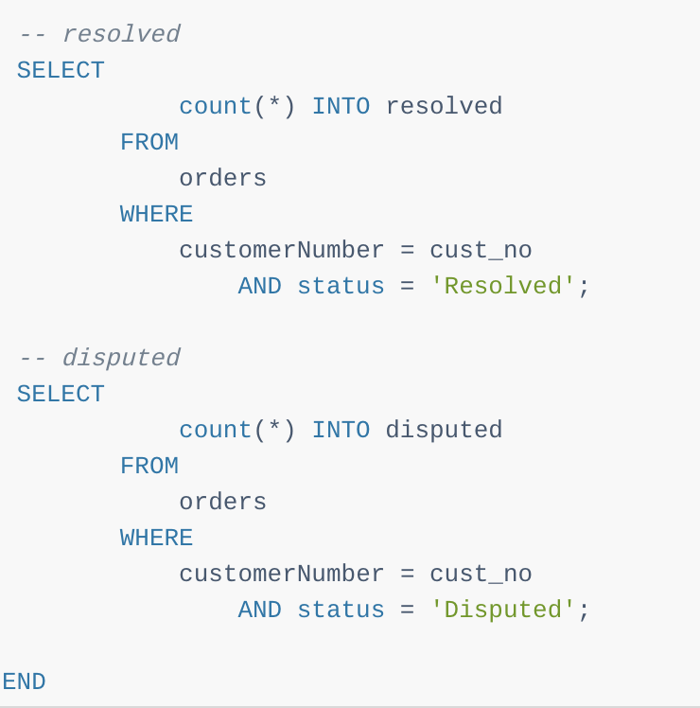

Slide 17
MySQL Procedure that Returns Multiple Values
In addition to the IN parameter, the stored procedure takes four additional OUT parameters: shipped, canceled, resolved, and disputed
Inside the stored procedure, you use a SELECT statement with the COUNT function to get the corresponding total of orders based on the order’s status and assign it to the respective parameter

Slide 18
MySQL Procedure that Returns Multiple Values
To use the get_order_by_cust stored procedure, you pass customer number and four user-defined variables to get the out values
After executing the stored procedure, you use the SELECT statement to output the variable values

Slide 19
Calling Stored Procedure that Returns Multiple Values From PHP
The following code snipper illustrates how to call a procedure that returns multiple values from PHP

Slide 20
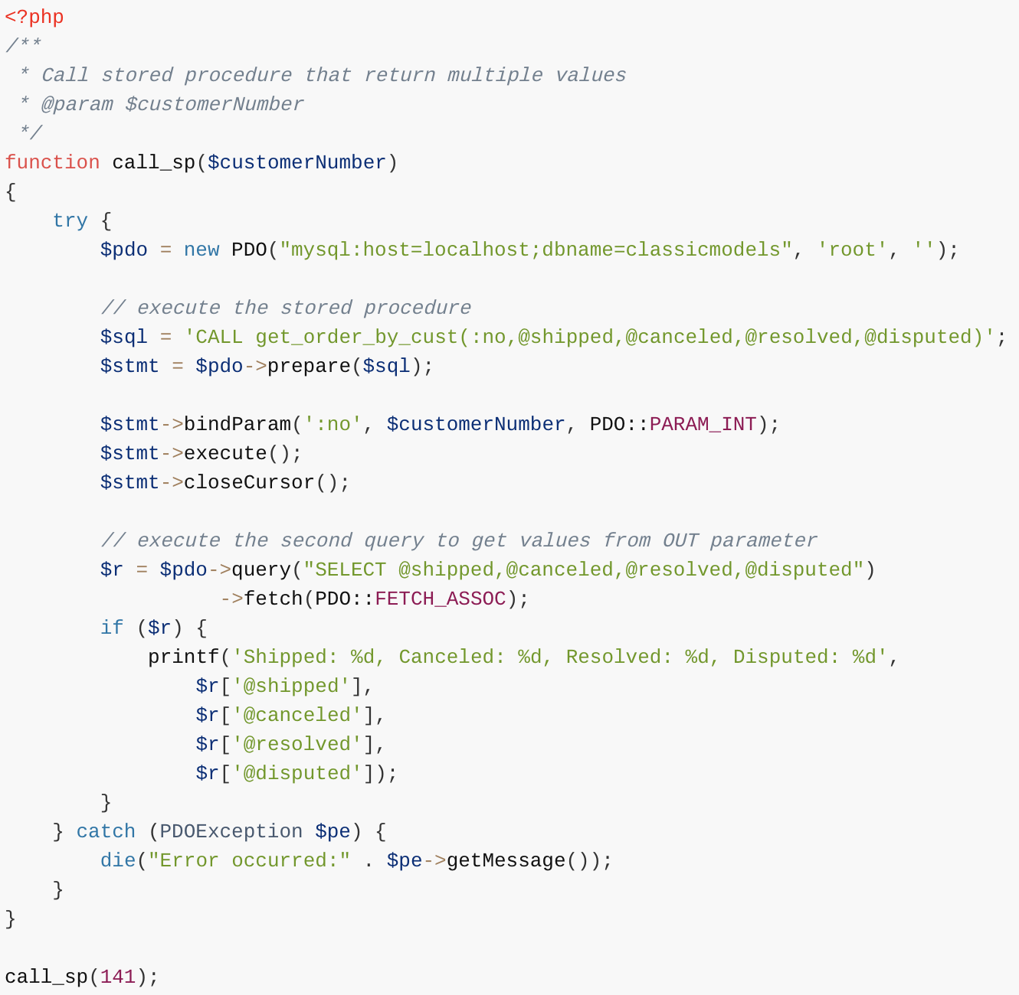

Slide 21
Raising Error Conditions with MySQL SIGNAL / RESIGNAL Statements
You use the SIGNAL statement to return an error or warning condition to the caller from a stored program
e.g., stored procedure, stored function, trigger or event
The SIGNAL statement provides you with control over which information for returning such as value andmessageSQLSTATE.

Slide 22
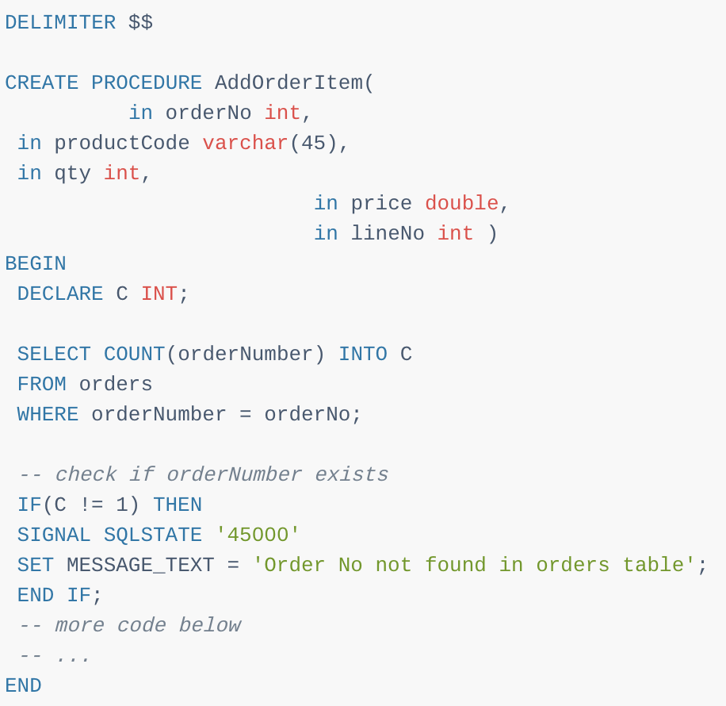
First, it counts the orders with the input order number that we pass to the stored procedure
Second, if the number of order is not 1, it raises an error with SQLSTATE 45000 along with an error message saying that order number does not exist in the orders table
Notice that 45000 is a generic SQLSTATE value that illustrates an unhandled user-defined exception

Slide 23
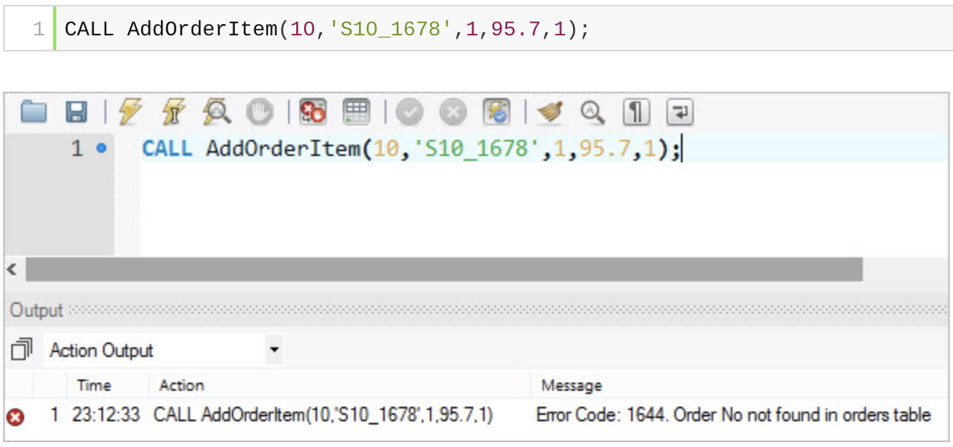
If we call the stored procedure AddOrderItem() and pass a nonexistent order number, we will get an error message

Slide 24
RESIGNAL
Besides the SIGNAL statement, MySQL also provides the RESIGNAL statement used to raise a warning or error condition
The RESIGNAL statement is similar to SIGNAL statement in term of functionality and syntax, except that:
You must use the RESIGNAL statement within an error or warning handler, otherwise, you will get an error message saying that “RESIGNAL when handler is not active”. Notice that you can use SIGNAL statement anywhere inside a stored procedure
You can omit all attributes of the RESIGNAL statement, even the SQLSTATE value

Slide 25
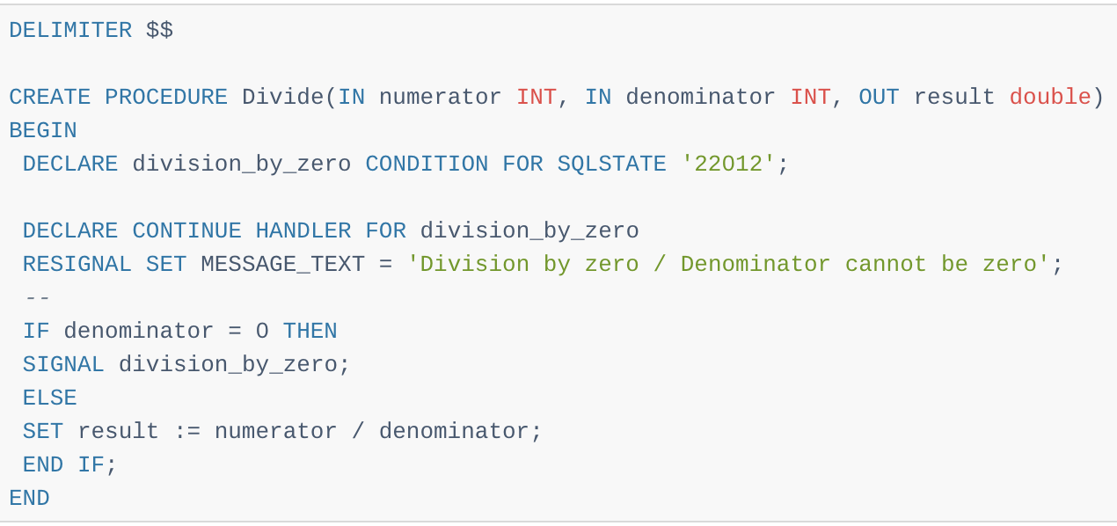
RESIGNAL
If you use the RESIGNAL statement alone, all attributes are the same as the ones passed to the condition handler

Slide 26
RESIGNAL

Slide 27
References
https://www.w3schools.com/sql/sql_stored_procedures.asp
https://dev.mysql.com/doc/connector-net/en/connector-net-tutorials-stored-procedures.html
http://www.mysqltutorial.org/mysql-signal-resignal/

Slide 28
SQL – Triggers

Slide 29
Definition
A trigger or database trigger is a stored program executed automatically to respond to a specific event
E.g., insert, update or delete occurred in a table
The database trigger is powerful tool for protecting the integrity of the data in your MySQL databases
In addition, it is useful to automate some database operations such as logging, auditing, etc.

Slide 30
Introduction
A SQL trigger is a set of SQL statements stored in the database catalog
A SQL trigger is executed or fired whenever an event associated with a table occurs e.g., insert, update or delete
A SQL trigger is a special type of stored procedure
It is special because it is not called directly like a stored procedure
The main difference between a trigger and a stored procedure is that a trigger is called automatically when a data modification event is made against a table whereas a stored procedure must be called explicitly

Slide 31
Advantages of using SQL triggers
SQL triggers provide an alternative way to check the integrity of data
SQL triggers can catch errors in business logic in the database layer
SQL triggers provide an alternative way to run scheduled tasks
By using SQL triggers, you don’t have to wait to run the scheduled tasks because the triggers are invoked automatically before or after a change is made to the data in the tables
SQL triggers are very useful to audit the changes of data in tables

Slide 32
Disadvantages of using SQL triggers
SQL triggers are invoked and executed invisible from the client applications, therefore, it is difficult to figure out what happens in the database layer
SQL triggers may increase the overhead of the database server

Slide 33
MySQL Triggers Implementation
A trigger can be defined to be invoked either before or after the data is changed by INSERT, UPDATE or DELETE statement
Before MySQL version 5.7.2, you can to define maximum six triggers for each table
BEFORE INSERT – activated before data is inserted into the table.
AFTER INSERT – activated after data is inserted into the table.
BEFORE UPDATE – activated before data in the table is updated.
AFTER UPDATE – activated after data in the table is updated.
BEFORE DELETE – activated before data is removed from the table.
AFTER DELETE – activated after data is removed from the table

Slide 34
MySQL Triggers Implementation
A trigger can be defined to be invoked either before or after the data is changed by INSERT, UPDATE or DELETE statement
Before MySQL version 5.7.2, you can to define maximum six triggers for each table
BEFORE INSERT – activated before data is inserted into the table.
AFTER INSERT – activated after data is inserted into the table.
BEFORE UPDATE – activated before data in the table is updated.
AFTER UPDATE – activated after data in the table is updated.
BEFORE DELETE – activated before data is removed from the table.
AFTER DELETE – activated after data is removed from the table
However, from MySQL version 5.7.2+, you can define multiple triggers for the same trigger event and action time.

Slide 35
MySQL Triggers Implementation
You must use a unique name for each trigger associated with a table. However, you can have the same trigger name defined for different tables though it is a good practice
You should name the triggers using the following naming convention:
For example, before_order_update is a trigger invoked before a row in the order table is updated.
(BEFORE | AFTER)_tableName_(INSERT| UPDATE | DELETE)
tablename_(BEFORE | AFTER)_(INSERT| UPDATE | DELETE) order_before_update is the same as before_order_update

Slide 36
MySQL Triggers Implementation

Slide 37
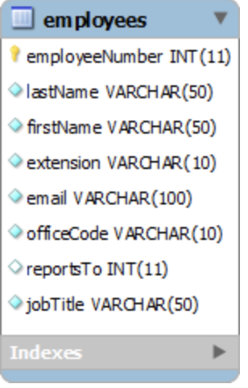
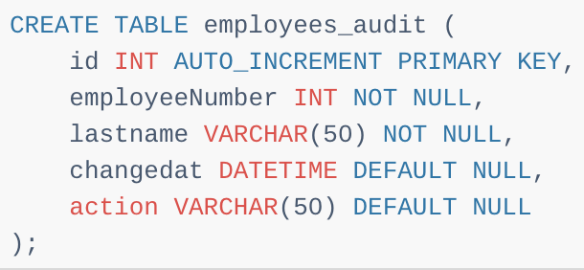
MySQL Triggers Implementation

Slide 38
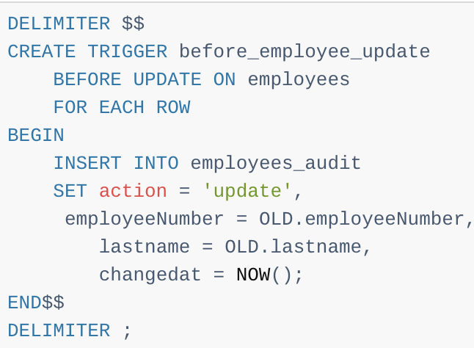
Create a BEFORE UPDATE trigger that is invoked before a change is made to the employees table
Inside the body of the trigger, we used the OLD keyword to access employeeNumber and lastnamecolumn of the row affected by the trigger

Slide 39
MySQL Triggers Implementation
Notice that in a trigger defined for INSERT, you can use NEW keyword only
You cannot use the OLD keyword
However, in the trigger defined for DELETE, there is no new row so you can use the OLD keyword only
In the UPDATE trigger, OLD refers to the row before it is updated and NEW refers to the row after it is updated

Slide 40
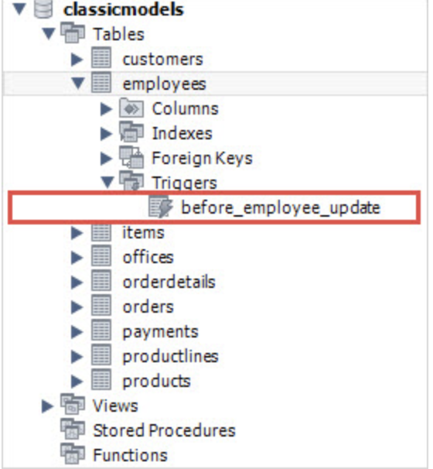
MySQL Triggers Implementation
To view all triggers:
SHOW TRIGGERS;

Slide 41
MySQL Triggers Implementation
Update to test if your trigger works:
UPDATE employees
SET
lastName = 'Phan'
WHERE
employeeNumber = 1056;

Slide 42
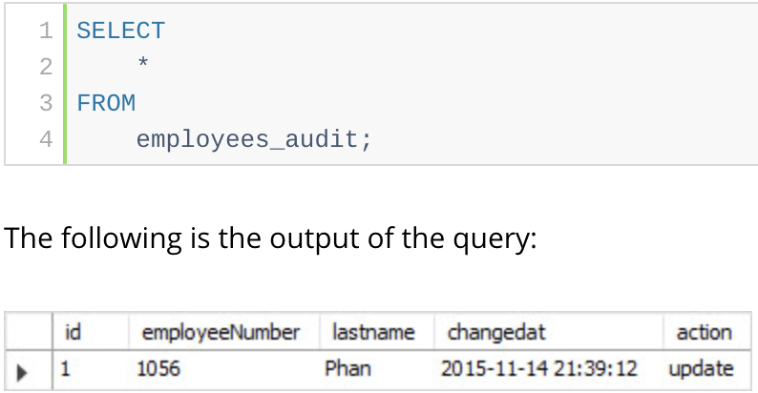
MySQL Triggers Implementation
Finally, to check if the trigger was invoked by the UPDATE statement, you can query the employees_audit table using the following query:

Slide 43
Triggers - Samples
Access DBMS GitHub Repository for more samples
https://github.com/sju-students-spring2019-dbms/DBMS/blob/master/Triggers.sql

Slide 44
Reference
http://www.mysqltutorial.org/mysql-triggers/create-multiple-triggers-for-the-same-trigger-event-and-action-time/

